Slide 1
WEB TECHNOLOGY PROJECT
S
Y
P
AVE
OUR
LACE
Sara Flauto, matricola: 0124002398

Slide 2
SYP: SAVE YOUR PLACE
Save Your Place is a Progressive Web Application that consists of a Drive which includes a variety of explorable places.

Slide 3
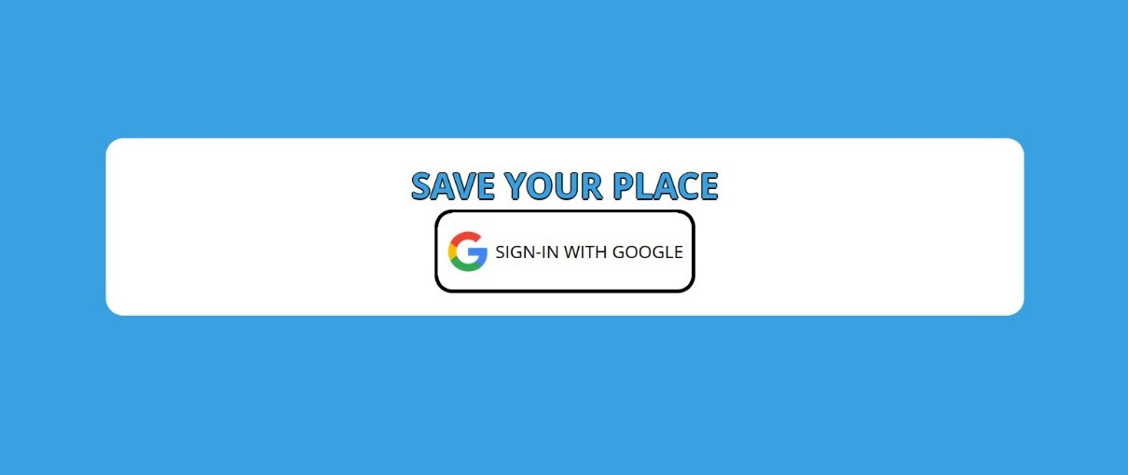
SYP: LOGIN
You can access to SYP by using your Google account when logging in.

Slide 4
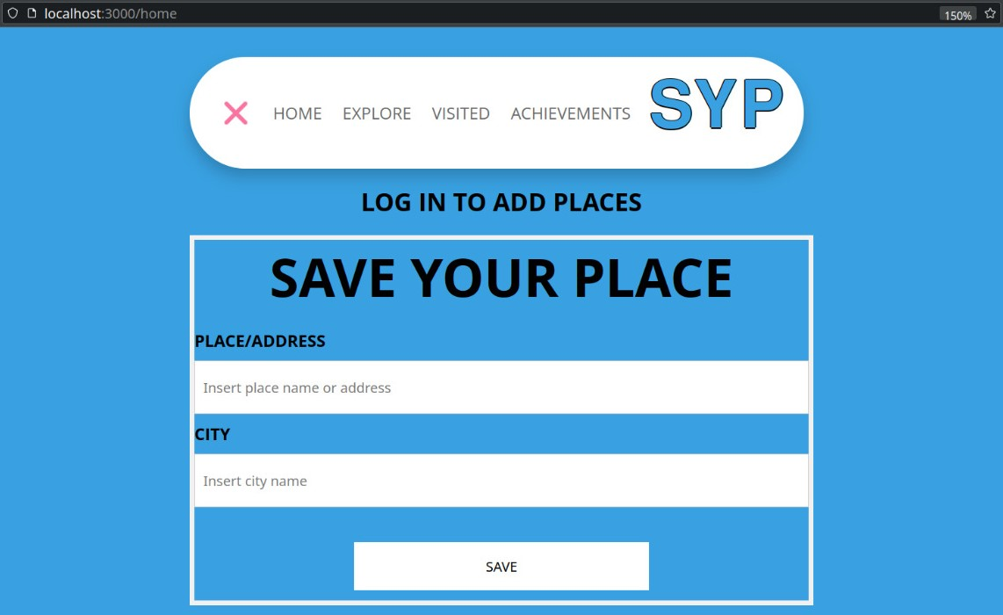
SYP: LOGIN
If you access the home page without first authenticating yourself by logging in, the phrase "LOG IN TO ADD PLACES" is displayed.
( This happens as well for the other pages )

Slide 5
SYP: SAVE YOUR PLACE
In the home page the user has the option to enter a variety of visitable places, each of these is identified by the “city” and “address” fields.

Slide 6
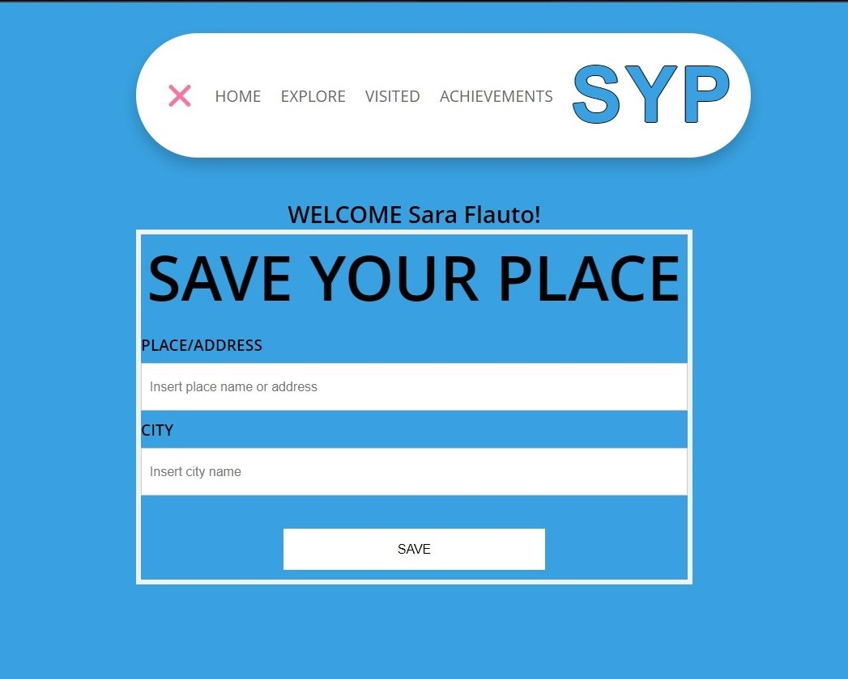
SYP: HOME PAGE

Slide 7
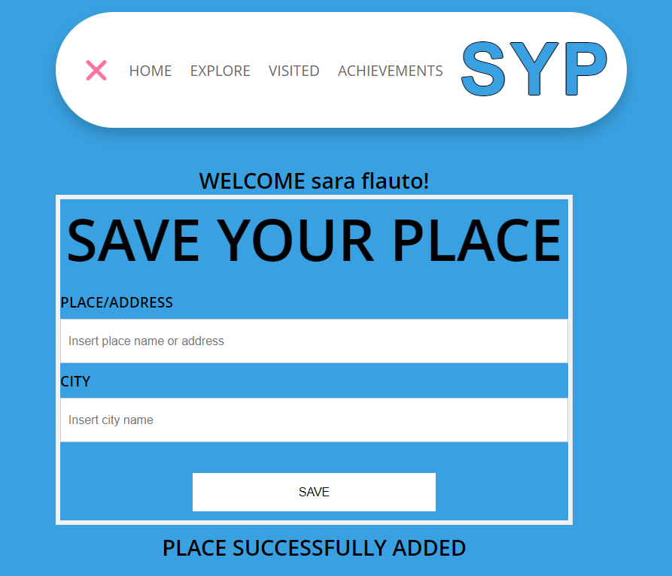

SYP: HOME PAGE
When a new place is entered correctly, the phrase "PLACE SUCCESSFULLY ADDED" is displayed.
When a place has already been entered, the phrase "ERROR: THE PLACE ALREADY EXISTS" is displayed.

Slide 8
From the homepage it is possible to have access to the places entered by the users. In fact the homepage includes a menu from which are displayed 3 fields:
1
EXPLORE
2
VISITED
3
ACHIEVEMENTS
Places to visit, i.e. places entered by the user which are not yet marked as completed.
Visited places, i.e. places entered by the user which are marked as completed.
Established achievements completed by the users when they visit a certain number of places: For each achievement reached, a score is assigned to the user.

Slide 9
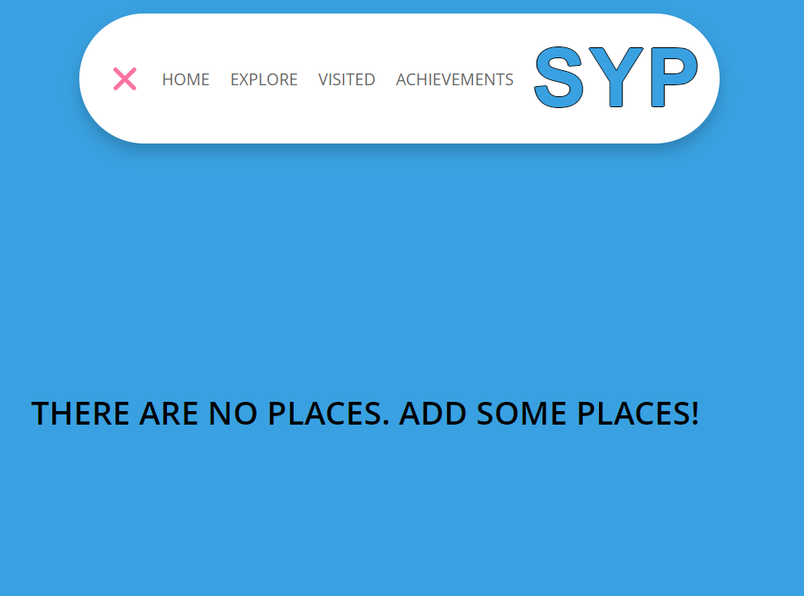
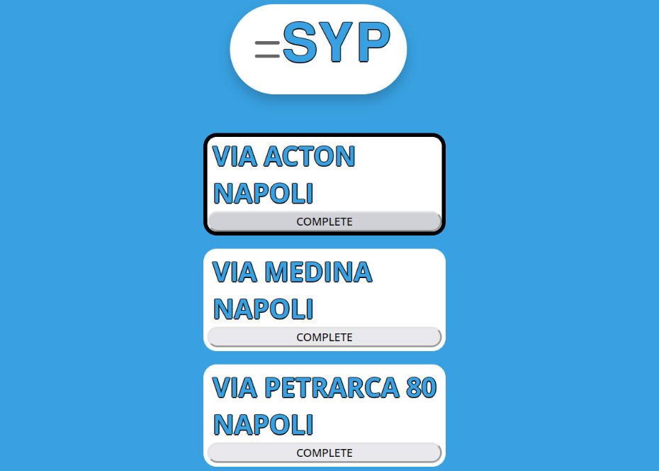
SYP: EXPLORE
When no place to visit has been added, the phrase "THERE ARE NO PLACES. ADD SOME PLACES!" is displayed.
When the places to visit have been entered each of them is displayed as it is shown in the following image.
After visiting them you can mark them as completed by clicking the "COMPLETE" button.

Slide 10
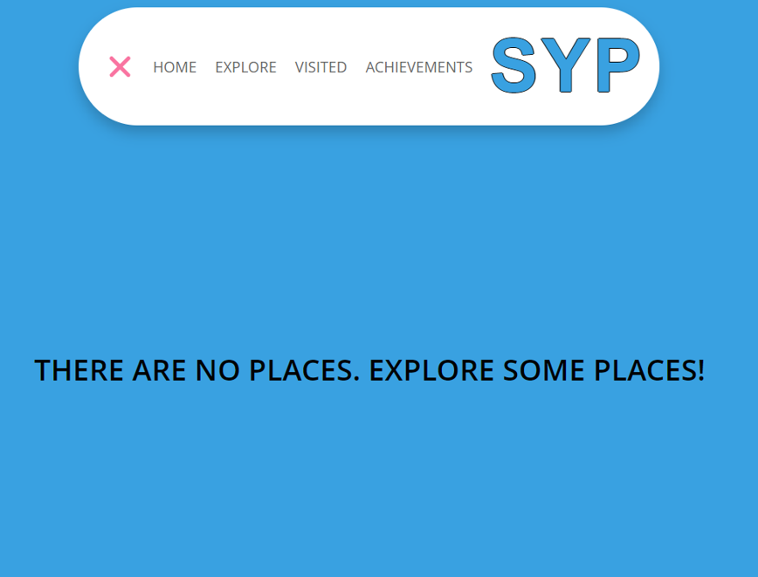
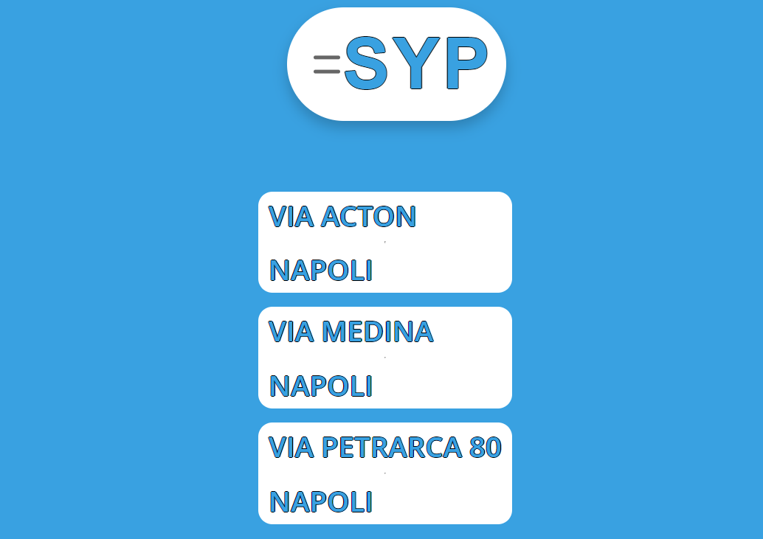
SYP: VISITED
When no place has been visited, the phrase "THERE ARE NO PLACES. EXPLORE SOME PLACES!" is displayed.
After the places to explore have been marked as completed they are displayed among those visited ones as shown in the following image.

Slide 11
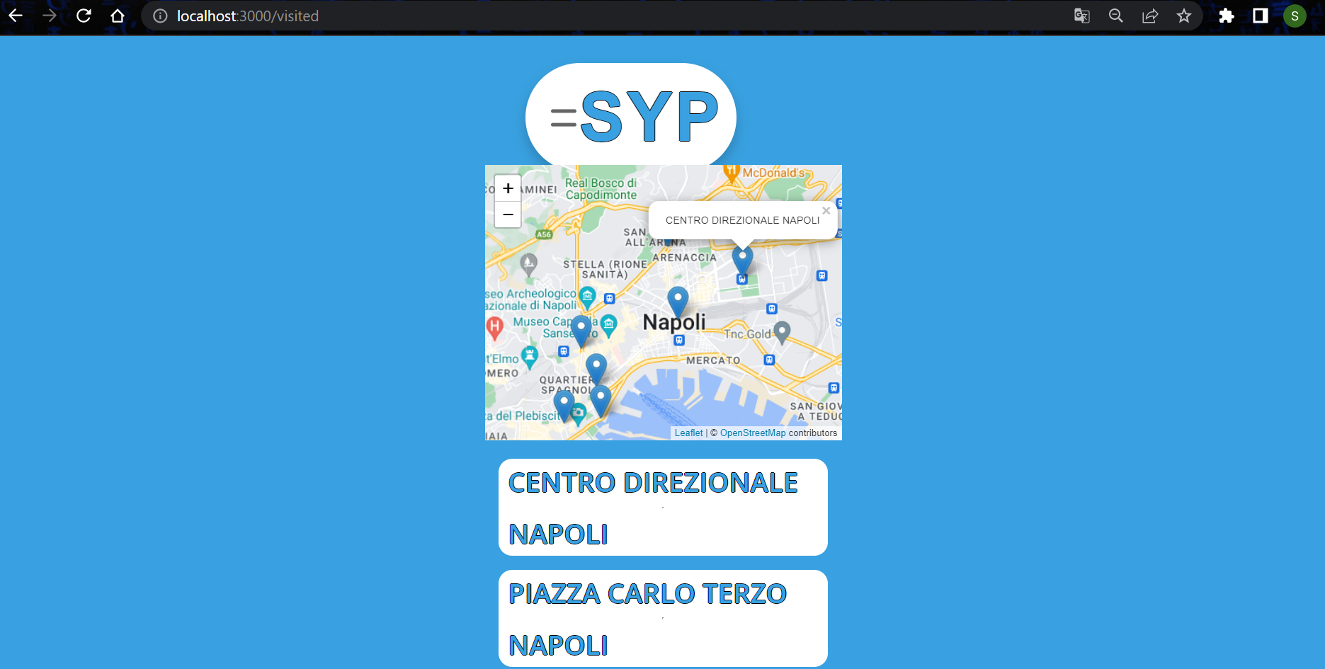
SYP: VISITED
Moreover, an interactive map was added to integrate the geolocation of the visited places.
The mapping features are illustrated in the following demonstration images.
Places visited are highlighted by the icon indicating the location. Clicking on each one will display a pop-up showing the name of the current place.

Slide 12
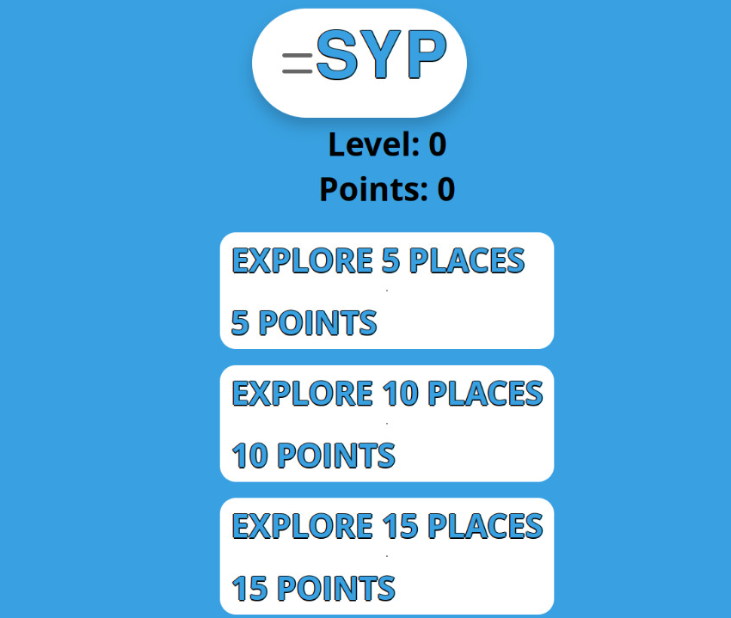
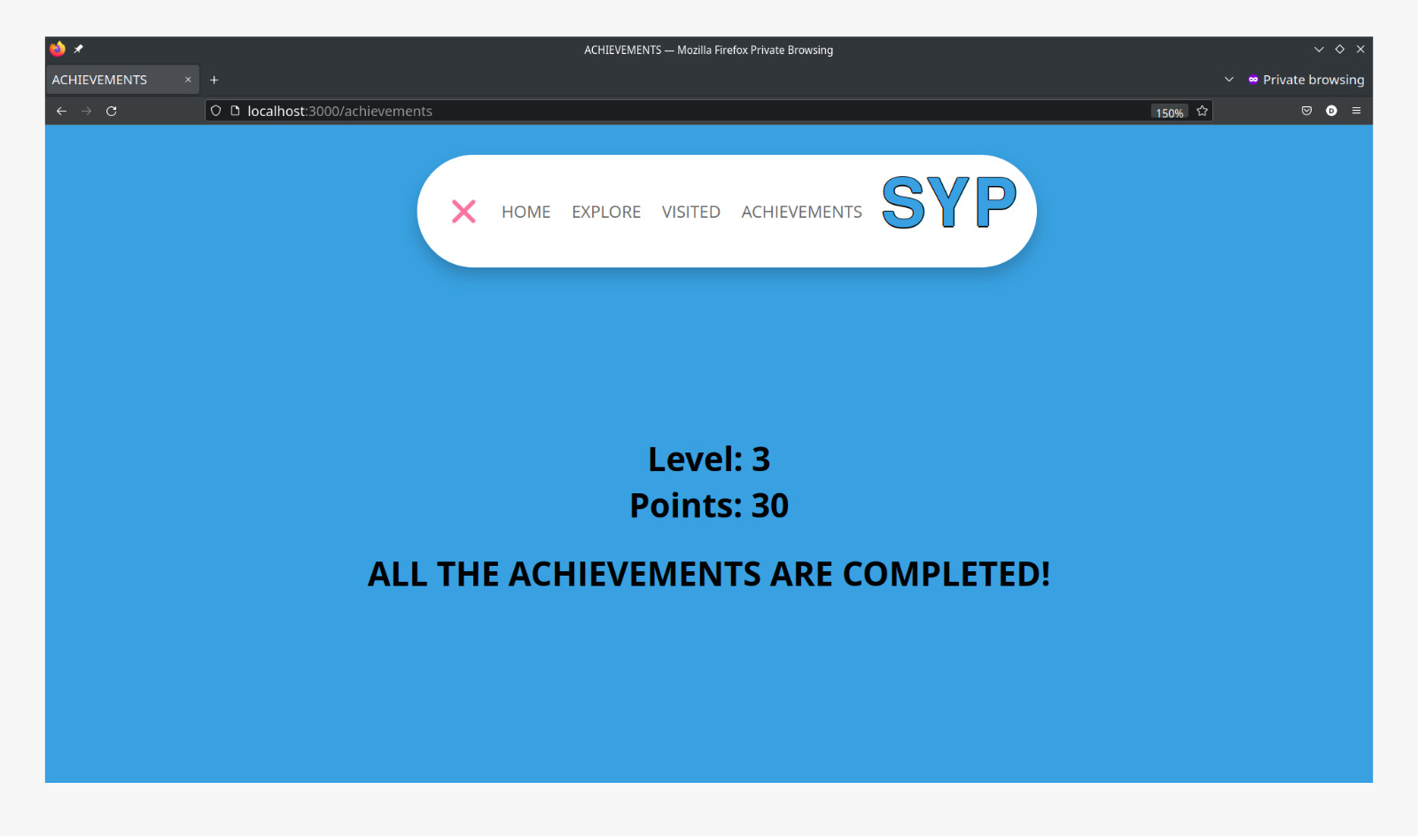
SYP: ACHIEVEMENTS
The "achievements" section shows challenges to be completed, with associated points. The user's current score and level are also displayed; these automatically increase based on the achievements completed.

Slide 13
SYP: SAVE YOUR PLACE
As it is shown in the previous image, in order to encourage competitiveness among users, depending on the number of goals completed each user earns a certain score. Based on their score they reach a certain level.

Slide 14

SYP: SAVE YOUR PLACE
All material regarding to this progressive web app is available at: git@github.com:saraflauto/Tecnologie_web_progetto.git

